Slide 1


Vocabulary Strategies for the STEM Classroom
Copyright 2012 S²TEM Centers SC
South Carolina Middle School Association
March 2, 2013
Copyright 2013 S²TEM Centers SC
Notes:
Vocabulary Strategies for the STEM Classroom
CEU #: 1350
ROOM #: Ballroom E
PRESENTERS: Gregory McDougal and Susie Teague
In this interactive session, experience and learn to use vocabulary strategies to support conceptual understanding of STEM language. Student samples and classroom video of strategies in use will be shared.

Slide 2
Inquiring Minds:
Reading to Learn and Innovate in Mathematics and Science
Copyright 2012 S²TEM Centers SC
Copyright 2013 S²TEM Centers SC
Notes:
IQMS Overview (Approx 10 min total)

Slide 3
IQ-MS is:
Copyright 2012 S²TEM Centers SC
A three-year research project supported by a challenge grant from Boeing SC and various other funding partners.
Focus: Enhancing STEM instruction with disciplinary literacy strategies.
Copyright 2013 S²TEM Centers SC

Slide 4
Disciplinary Literacy
Copyright 2012 S²TEM Centers SC
Advanced literacy instruction, embedded within content areas, that engages learners with content in ways that mirror what scientists and mathematicians do to inquire and gain understanding in their disciplines
Copyright 2013 S²TEM Centers SC
Notes:
I still think we need to establish what we’re about even if we don’t get into IQMS project.

Slide 5
Total Instructional Focus
High Quality STEM Instruction
Purposeful Reading
Productive Dialogue
Meaningful Writing
Copyright 2013 S²TEM Centers SC
Notes:
IQ-MS Summer Institute 2012 Focus on Purposeful Reading
S2TEM Centers SC
5

Slide 6
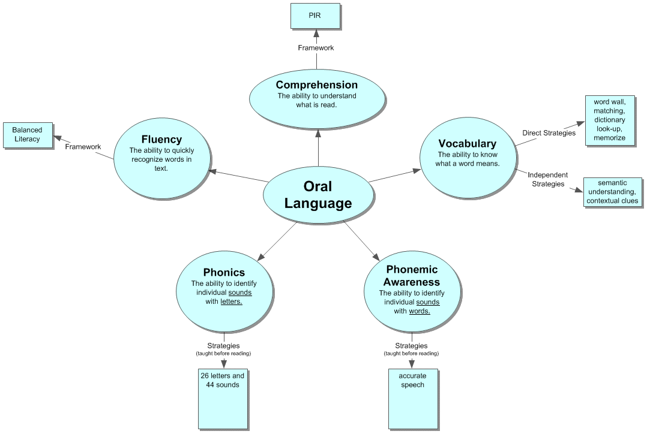
5 Big Ideas of READING
Copyright 2013 S²TEM Centers SC
Notes:
A Theoretical Framework for Reading – the big ideas.
6

Slide 7
Snoker
A snoker is produced by the initiation of a succession of compressive and rarefactive disturbances in a medium capable of transmitting these vibrational disturbances. Particles of the medium acquire energy from the vibrating source and enter the vibrational mode themselves. The wave energy is passed along to adjacent particles as the periodic waves travel through the medium.
Adapted from MacDougall, 2003
Text from high school textbook Modern Physics, 1990
Notes:
Problems with science vocabulary.
Questions
How is a snoker produced?
What happens when particles get energy?
What happens as the waves travel through a medium?
7

Slide 8
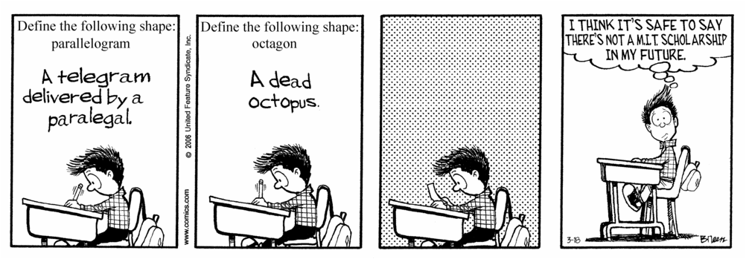

Notes:
Click for white text boxes to disappear as you read the words aloud…
Transition slide into strategies…

Slide 9
Frayer Model
D
Definition (in own words)
Characteristics
Concept
Examples (from own life)
Nonexamples (from own life)
Notes:
Frayer Model video of Mrs. Ward (7th grade math teacher) setting up the model.
“This vocabulary strategy is quite popular. How many have used it before?”
Let’s take a look at what some of our students have done…

Slide 10
View Video
Copyright 2013 S²TEM Centers SC

Slide 11
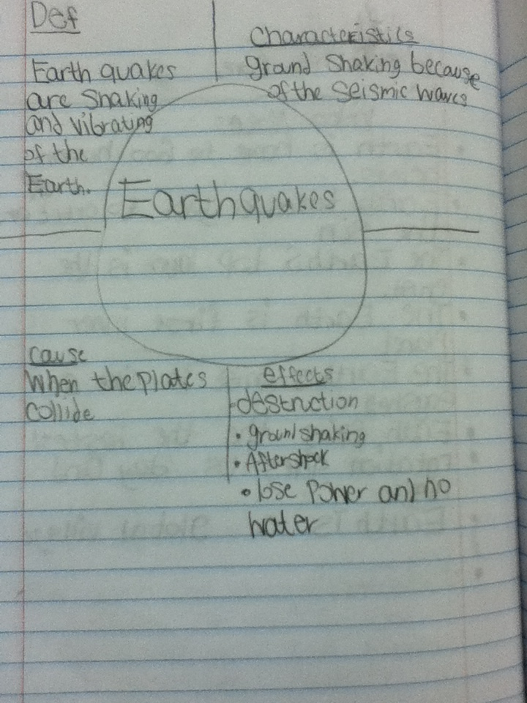
Frayer Student Work
Frayer Model
Copyright 2013 S²TEM Centers SC
Notes:
Mrs. Greer will share her experiences with Frayer. These 2 examples are from her students.

Slide 12
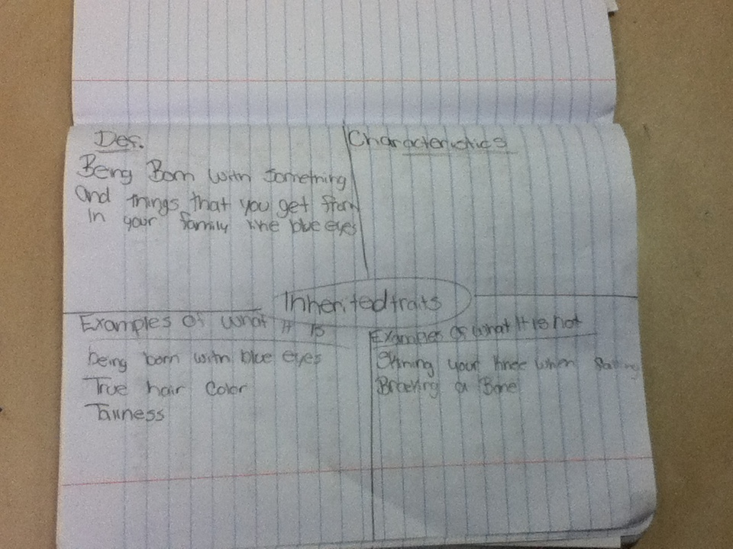
Frayer Model
Copyright 2013 S²TEM Centers SC

Slide 13
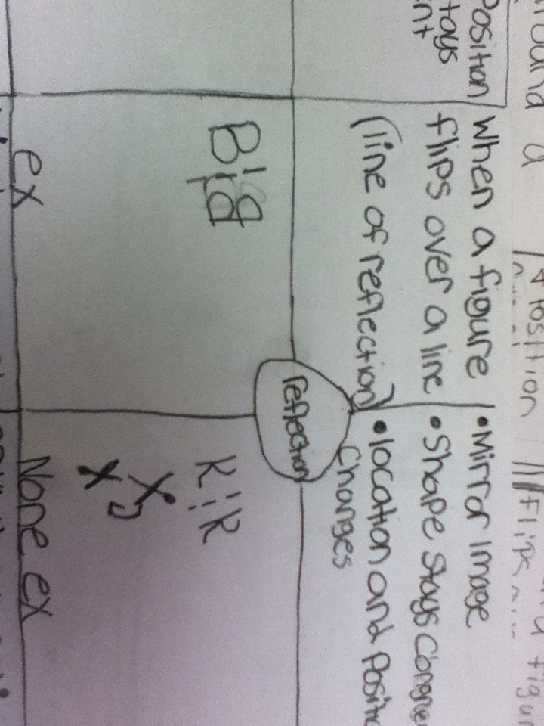
Frayer Model
Copyright 2013 S²TEM Centers SC

Slide 14
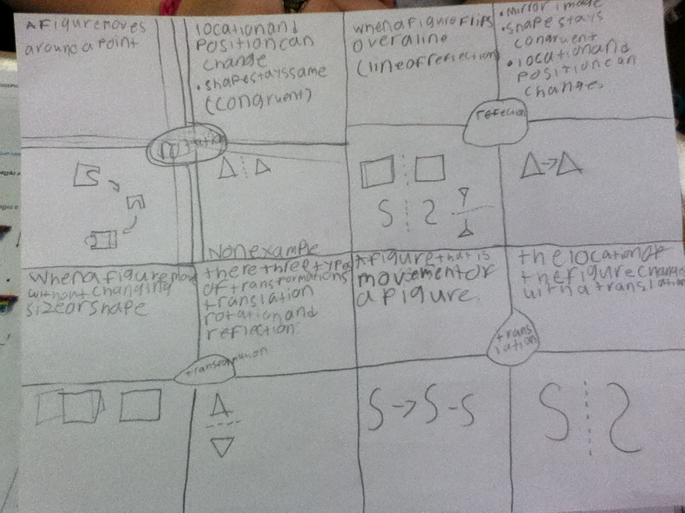
Frayer Student Work
Frayer Model
Copyright 2013 S²TEM Centers SC
Notes:
These 2 examples are from a math class I did Frayer with.

Slide 15
Concept Map
2
1
3
7
6
5
4
Copyright 2013 S²TEM Centers SC
Notes:
Imagine these were your word wall vocabulary words…let’s make it living and turn it into a concept map.
IN a concept map, provide kids with vocab words you wish for students to use. Have them connect words as THEY see the relationships and draw lines/arrows to show that connection. We had them number their arrows/lines for the next step. Their next step is to write that relationship in sentence format. (We’ve had them underline the vocab words in the sentence or “bold” them.) As students were learning these, we had them write their relationship each time they drew an arrow. Once they “get the hang of it” they may wish to draw all of the relationships and then go back and write. Sometimes, students chose to write their sentences directly on their maps!

Slide 16
View Video

Slide 17
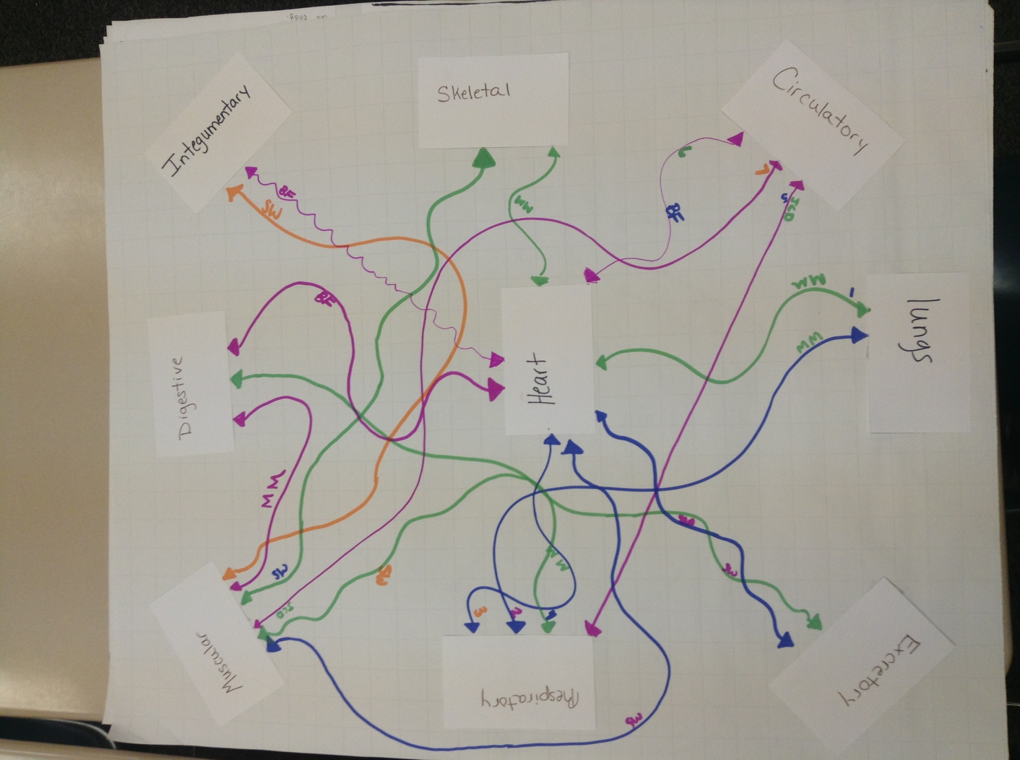
Copyright 2013 S²TEM Centers SC

Slide 18
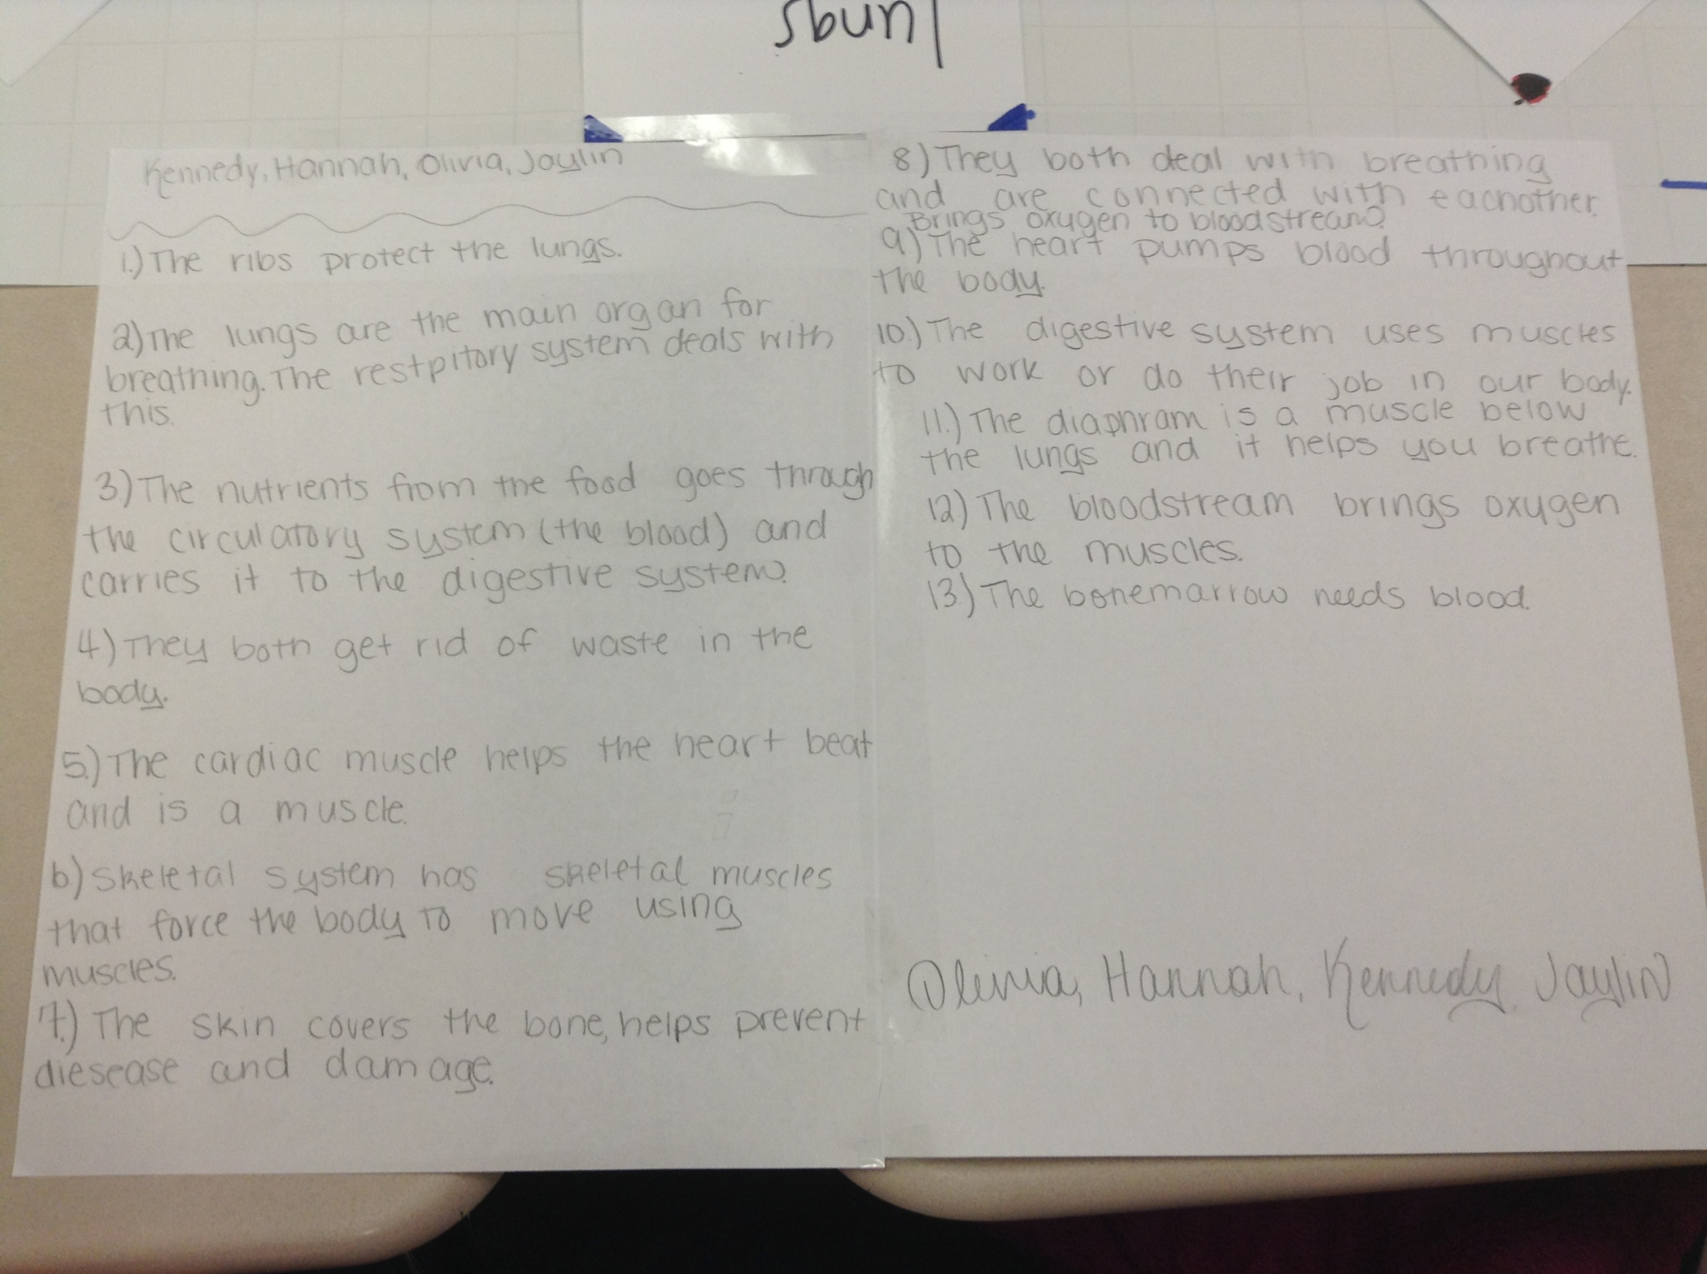
Vocabulary Concept Map
Copyright 2013 S²TEM Centers SC

Slide 19
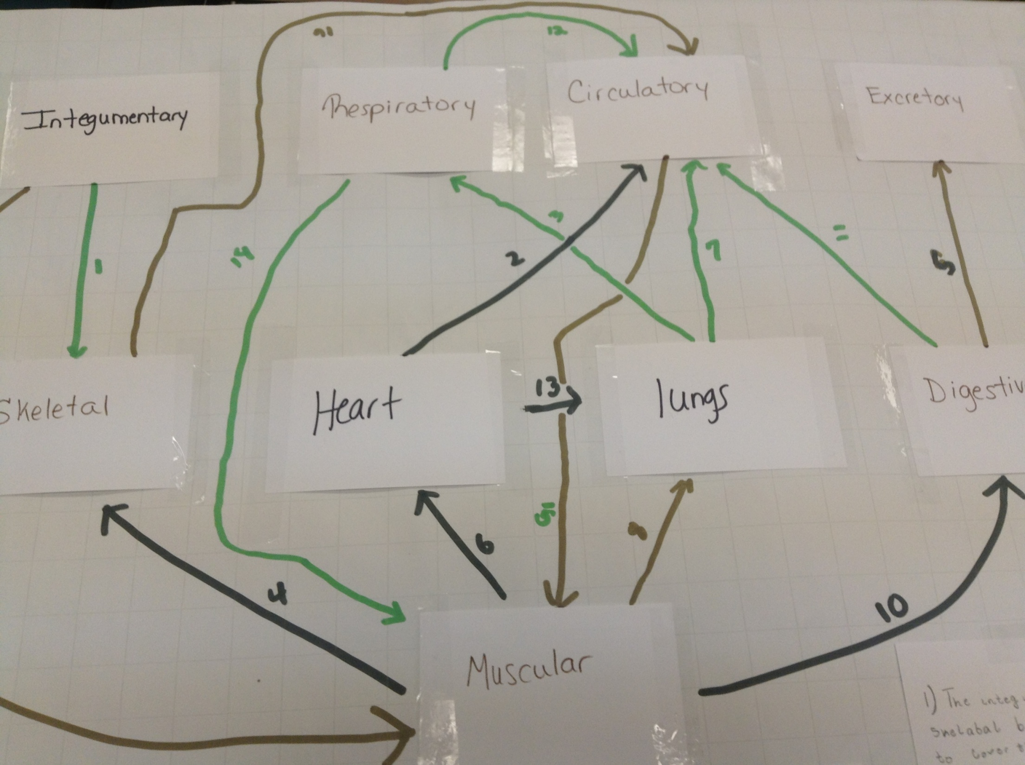
Vocabulary Concept Map
Copyright 2013 S²TEM Centers SC

Slide 20
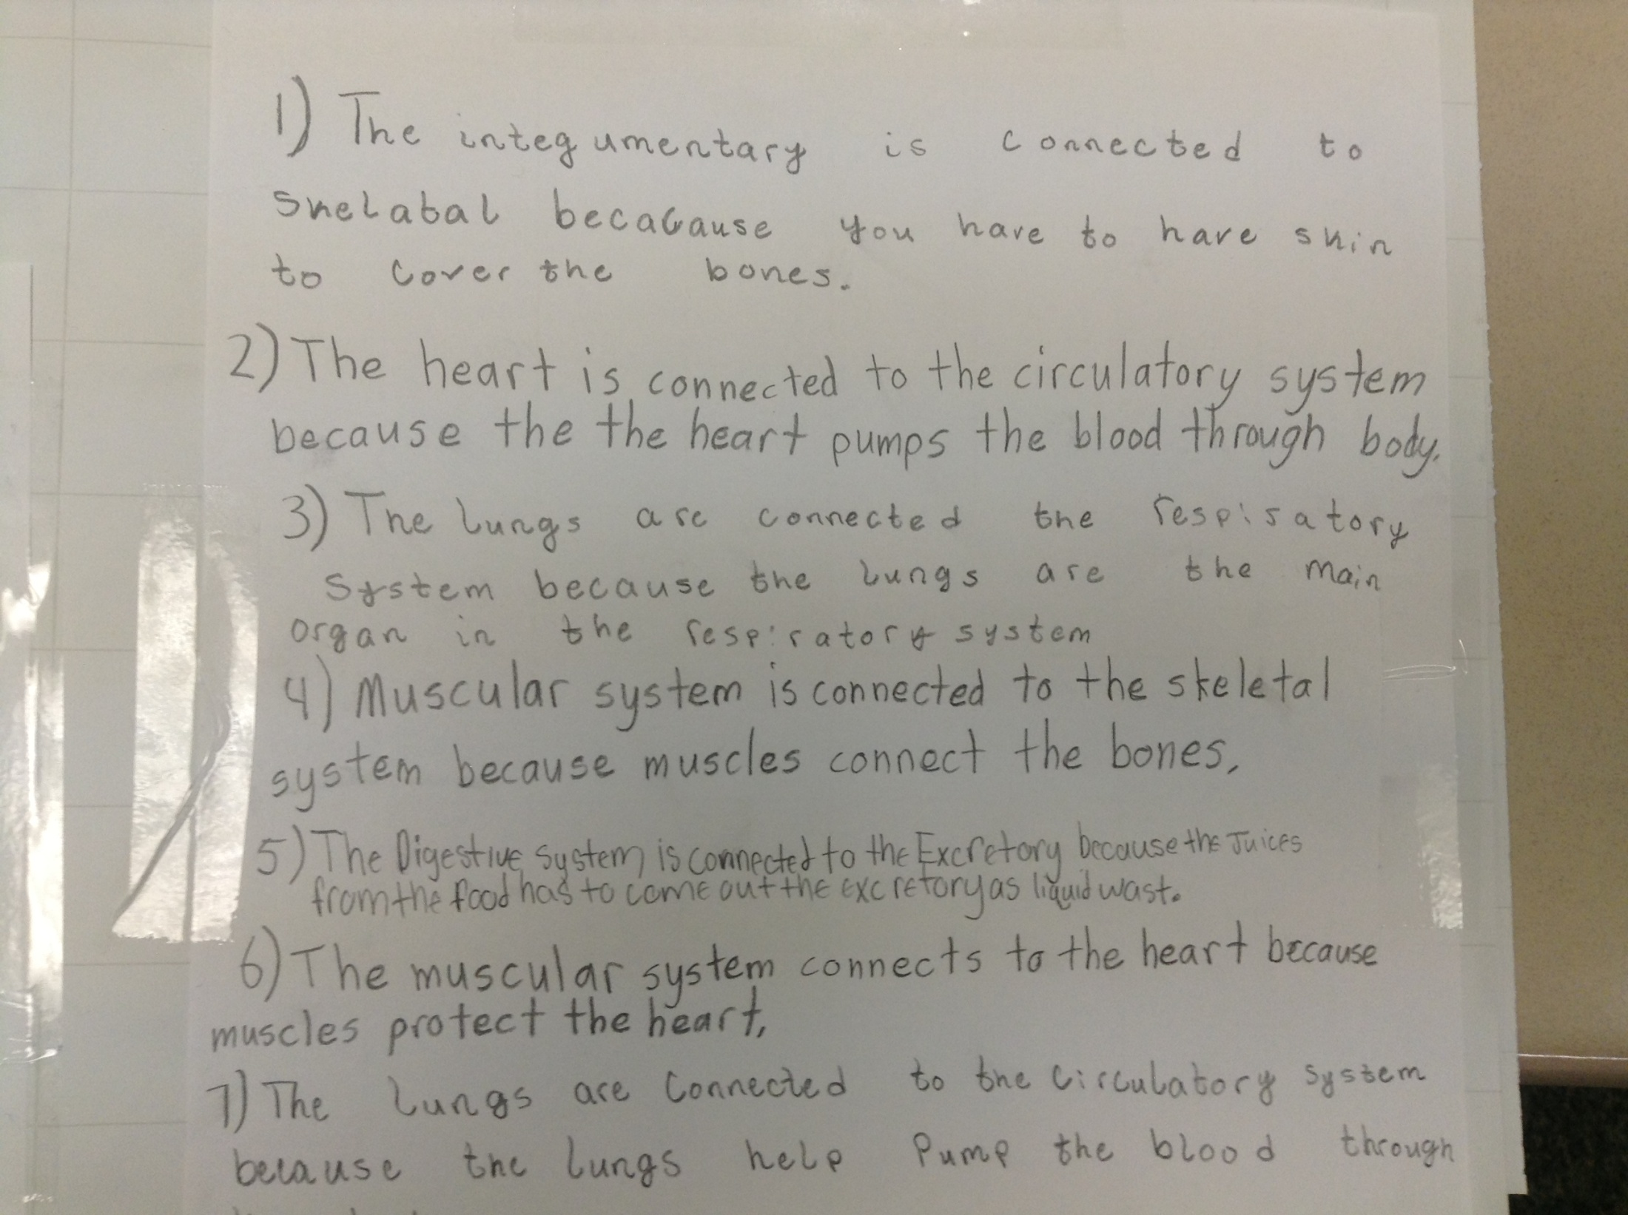
Copyright 2013 S²TEM Centers SC

Slide 21
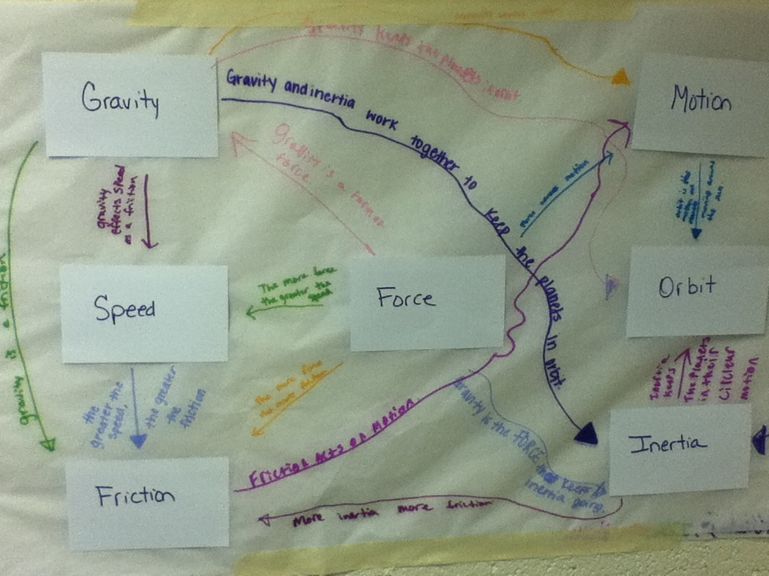
Vocabulary Concept Map
Copyright 2013 S²TEM Centers SC
Notes:
For this assignment, students were given vocabulary words from forces and motion unit (8th gr science). They placed the words and connected them as they saw they needed to fit together. Then number the words and wrote sentences describing the relationship of the connections. Finally, they created the wurdle.
Mrs. Greer will have video of her students doing concept maps. Place Holder for Video of students creating concept map

Slide 22
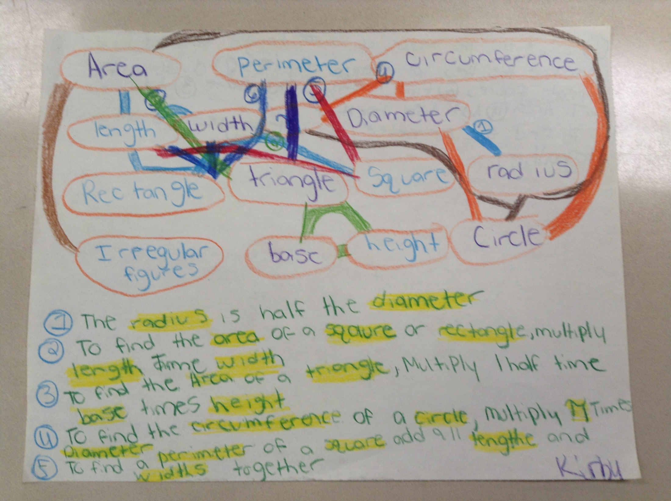
Copyright 2013 S²TEM Centers SC
Vocabulary Concept Map
Notes:
INFO FOR PRESENTER ON USING WORD WALL WORDS AS A LIVING WORD WALL:
Display vocabulary that students need to master and be able to access as they learn new content
Should be fluid and interactive (sort and re-sort words)
Write words for unit of study on index cards (you may want to laminate these since they’ll be moved around frequently)
Add vocabulary as it is taught
Resort by various characteristics (as necessary)
Whitaker, Sanda R. Word Play: Building Vocabulary Across Texts and Disciplines Grades 6-12, Heinemann, 2008.
One of the strategies you had said you wanted to use in all classrooms is Word Walls. How have you seen these used in the past?
Typically, they are seen with random words placed on the wall, either stuck in sentence strip chart or organized alphabetically. While word walls displaying random collections of words are better than no words at all, those that are used for specific purposes and sets of vocabulary/concepts help clarify students’ understanding. Academic word walls display vocab that students need to master and be able to access as they learn new content.
NOTE: not all of the words need to be “in play” all of the time. Limiting the number of words/categories will assist lower level students as well as ELL.

Slide 23
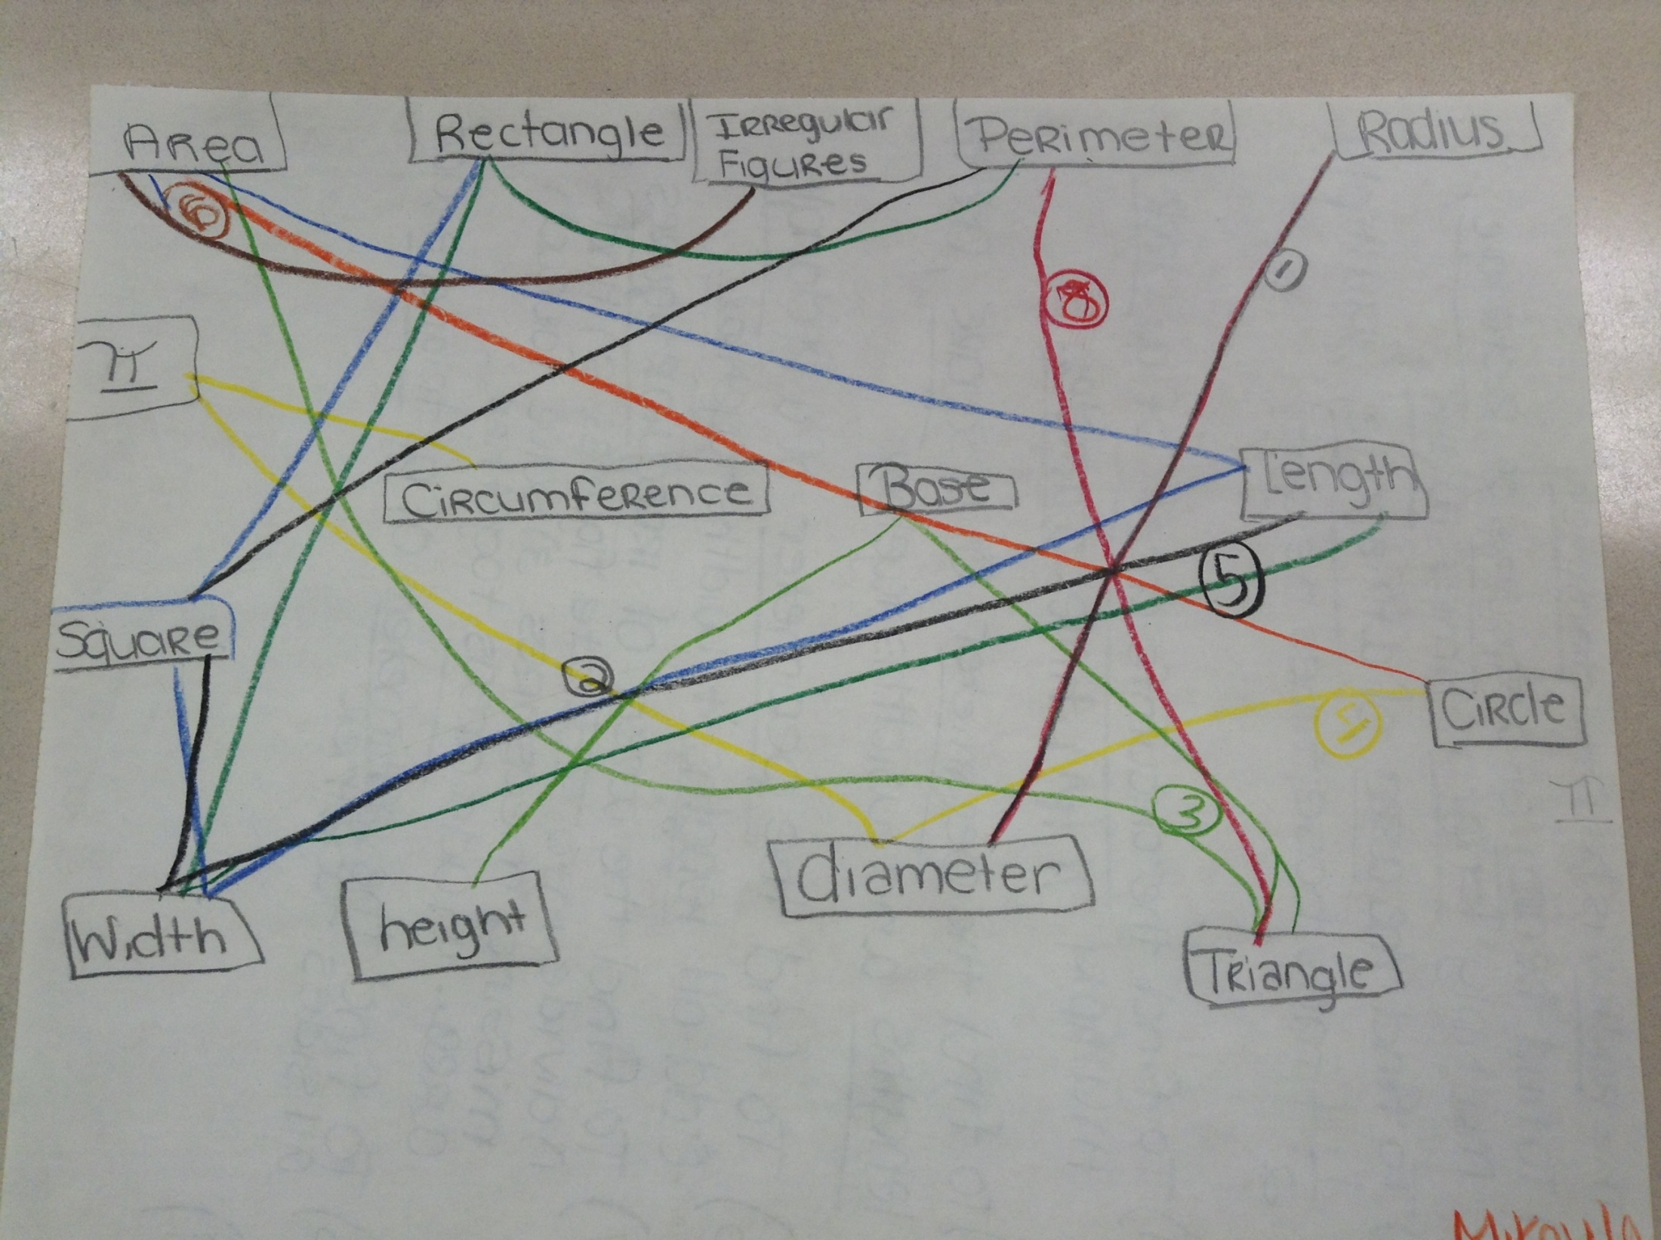
Copyright 2013 S²TEM Centers SC
Vocabulary Concept Map

Slide 24
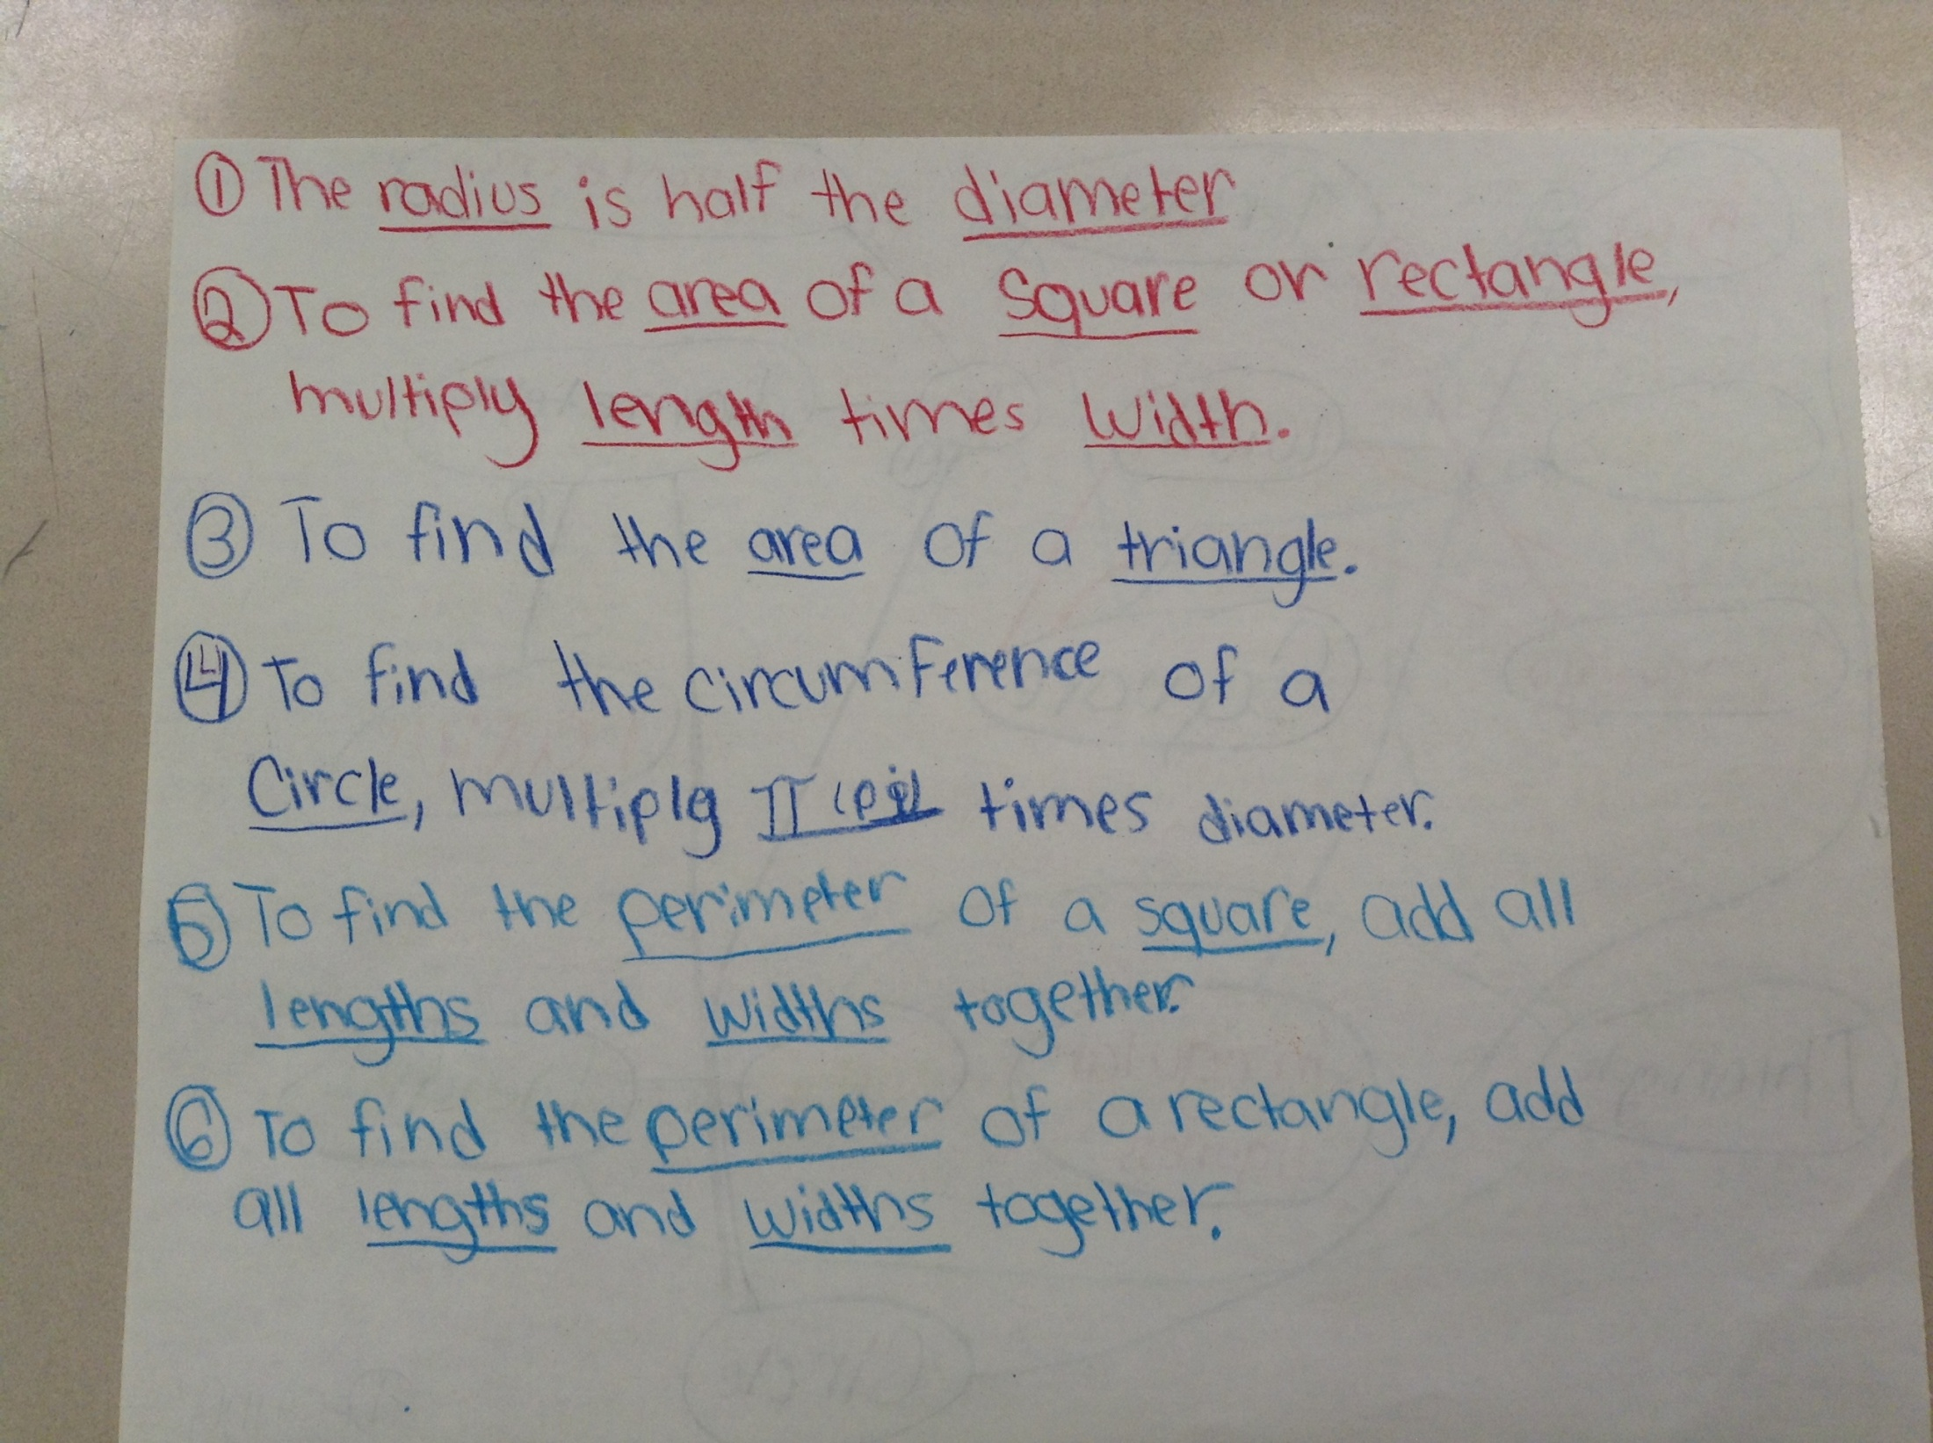
Vocabulary Concept Map

Slide 25
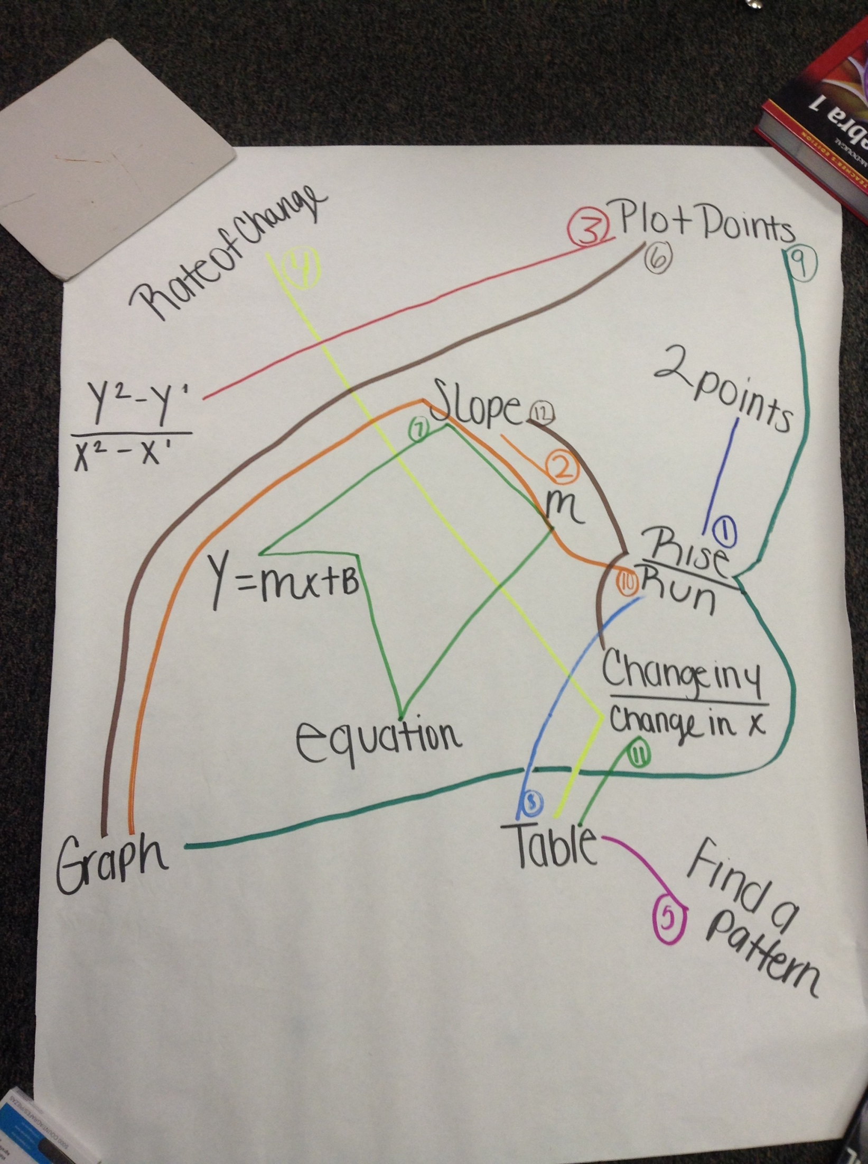
Vocabulary Concept Map
Copyright 2013 S²TEM Centers SC

Slide 26
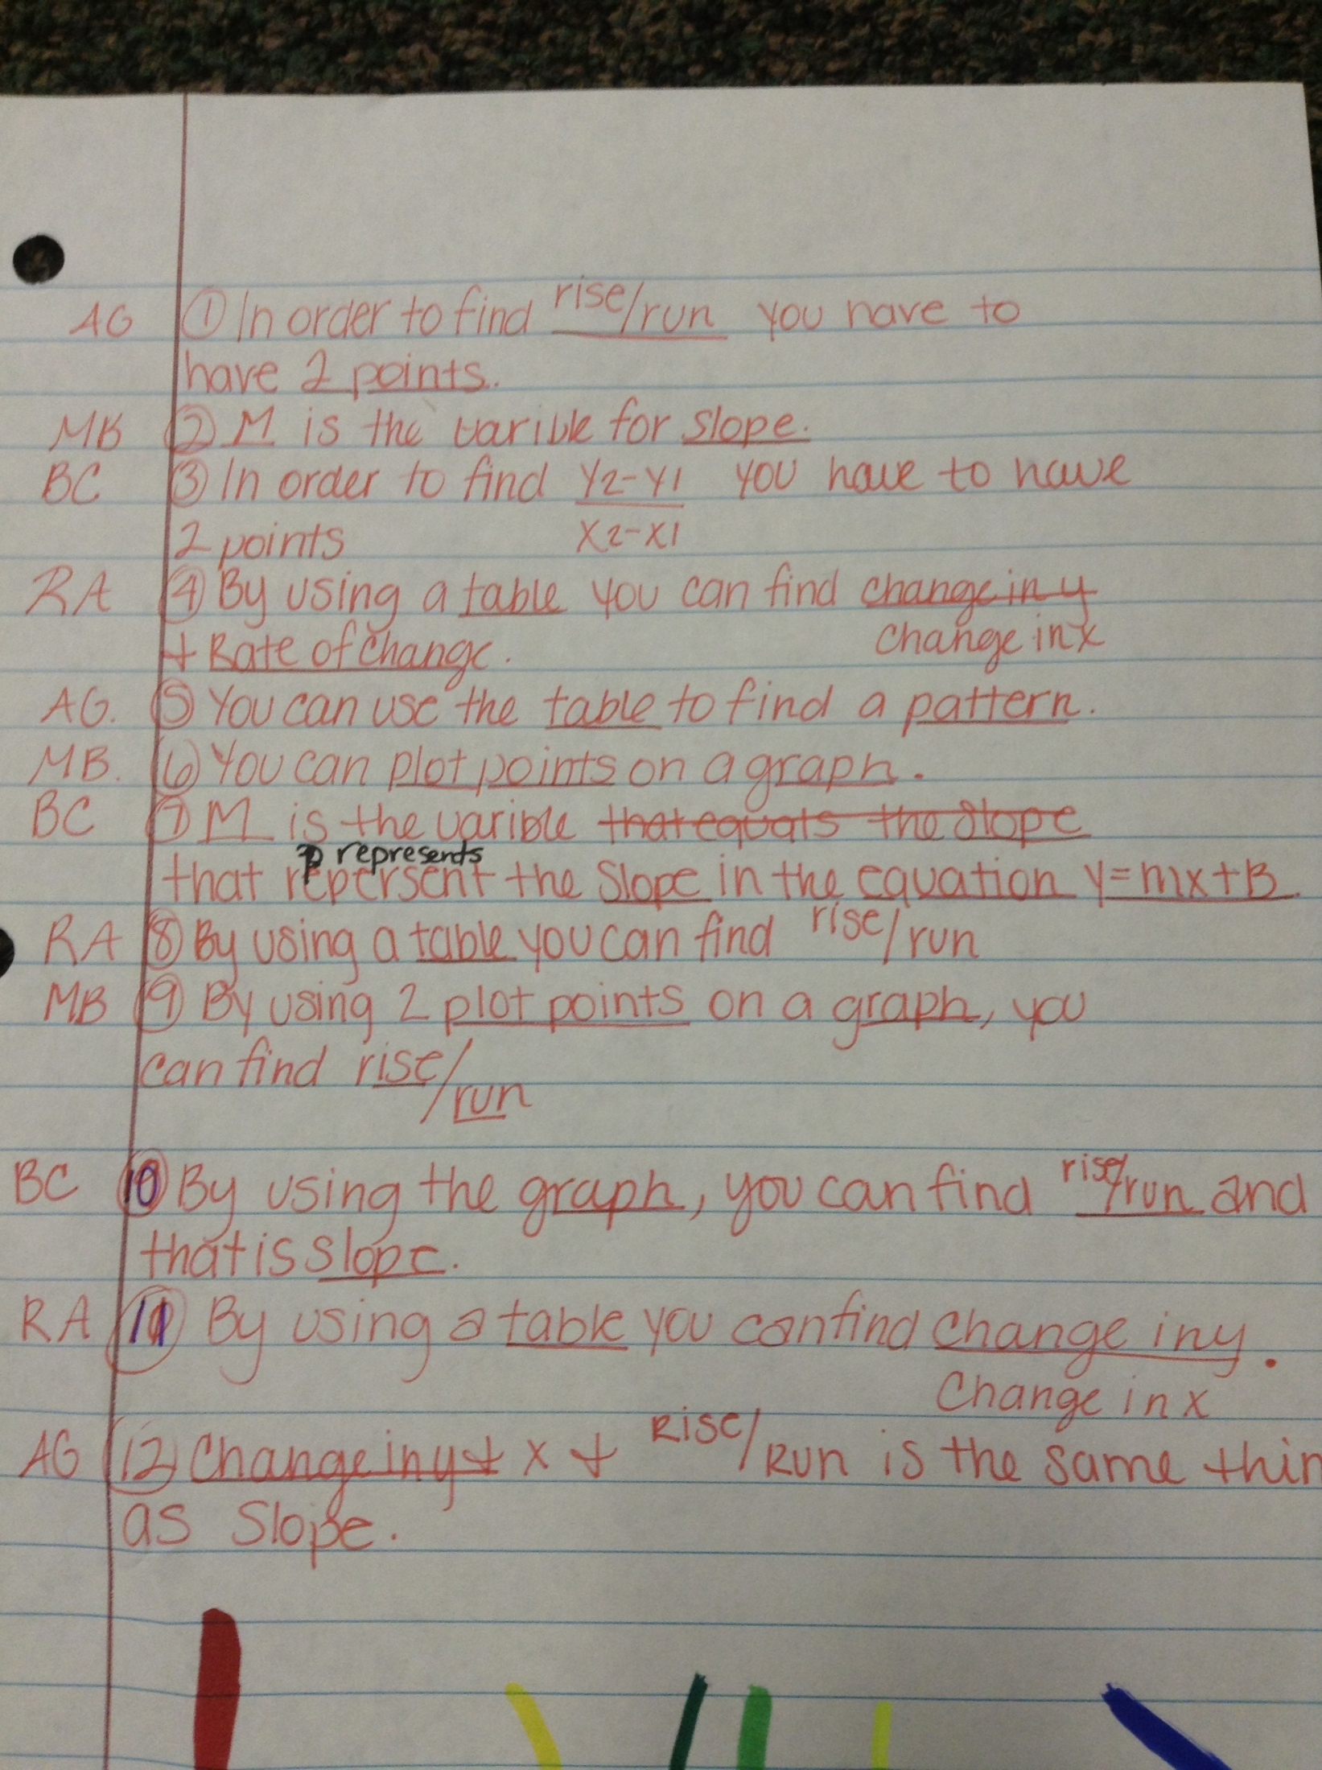
Copyright 2013 S²TEM Centers SC

Slide 27

What’s in a Tweet?
Synthesize thinking in 140 Characters (includes punctuation and spaces)
Reflective writing
Answer to a focus question
Writing definition/example
of vocabulary terms
Copyright 2013 S²TEM Centers SC
Notes:
Twitter photo
http://www.google.com/imgres?q=twitter+photos&hl=en&sa=X&rlz=1I7ADBS_en&biw=1680&bih=968&tbm=isch&tbnid=dvO1okGLblLtiM:&imgrefurl=http://www.mediabistro.com/alltwitter/3-tips-for-writing-a-killer-twitter-bio-to-get-targeted-followers_b133&docid=5jDhPLYoiPw42M&imgurl=http://www.mediabistro.com/alltwitter/files/2010/11/twitter-follow-achiever.jpg&w=500&h=371&ei=sfAwUdzZJYrM9ATTwIGYBw&zoom=1&iact=rc&dur=812&sig=112992723880687212557&page=1&tbnh=188&tbnw=254&start=0&ndsp=31&ved=1t:429,r:2,s:0&tx=136&ty=107

Slide 28
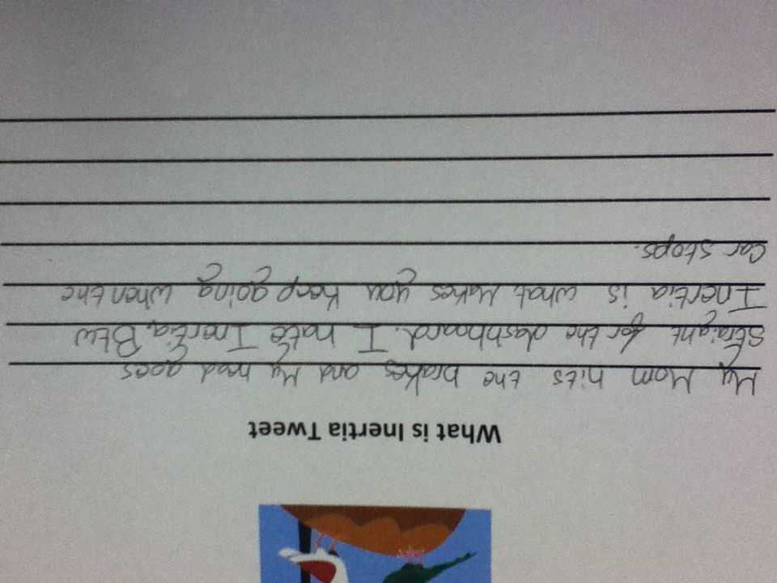
Copyright 2013 S²TEM Centers SC

Slide 29
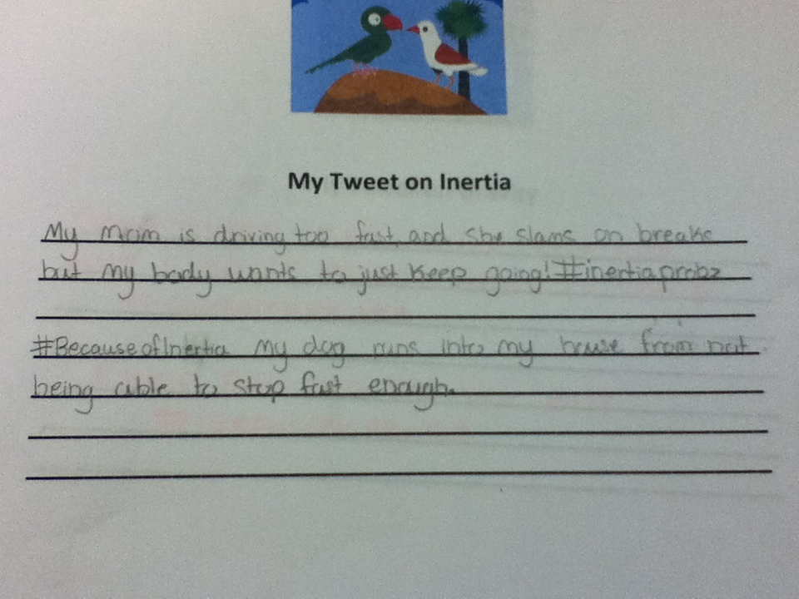
Copyright 2013 S²TEM Centers SC

Slide 30
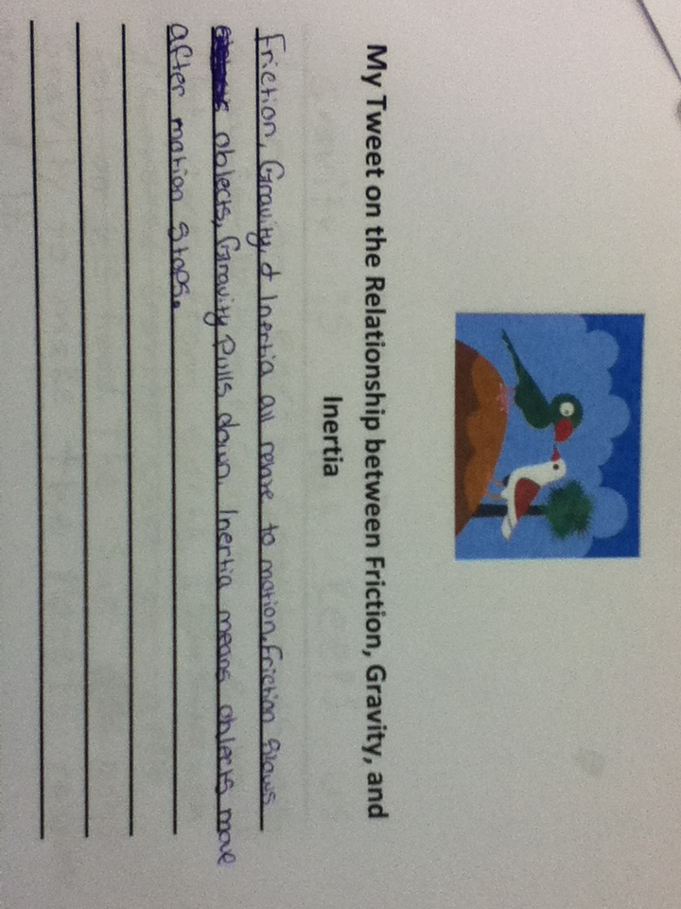
Copyright 2013 S²TEM Centers SC

Slide 31
View Video

Slide 32

It’s Your Turn to TWEET!
In what ways will you implement some of these strategies in your classroom?
Copyright 2013 S²TEM Centers SC
Notes:
Twitter photo
http://www.google.com/imgres?q=twitter+photos&hl=en&sa=X&rlz=1I7ADBS_en&biw=1680&bih=968&tbm=isch&tbnid=up64UIJ6Qa3AGM:&imgrefurl=http://higher-and-higher.com/2010/12/07/13-twitter-chats-for-pr-pros/&docid=kJ-FT4SglsQGtM&imgurl=http://higher-and-higher.com/wp-content/uploads/2010/12/twitter-icon-1a.png&w=256&h=256&ei=jPkwUZPvCoG-8ASzyICADw&zoom=1&ved=1t:3588,r:25,s:0,i:166&iact=rc&dur=665&sig=112992723880687212557&page=2&tbnh=177&tbnw=175&start=25&ndsp=32&tx=105&ty=63

Slide 33
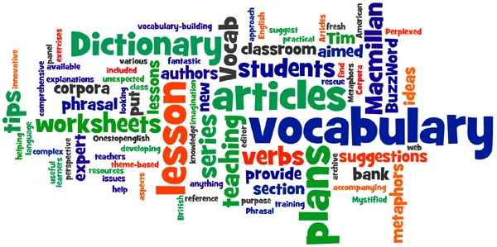
“A word is not a crystal, transparent and unchanged; it is the skin of a living thought and may vary greatly in color and content according to the circumstance and time in which it is used.” Oliver Wendell Holmes, Jr.
Notes:
Billmeyer, Rachel & Mary Lee Barton, Teaching Reading in the Content Areas: If Not Me, Then Who?, 2nd Ed., McRel, 1998.
Each content area has its own unique vocabulary. Content area vocab differs greatly from the vocabulary that students study in literature-based classes; therefore, it is essential that content area teachers incorporate vocab work into planning and instruction. The key to developing vocabulary is choosing the right strategy to help students learn, understand, and make meaning of the content. By the end of our time together, you’ll leave with a few vocabulary strategies to use in any content area. Try them and let us know how they work! ☺
Let’s begin our strategies…

Slide 34


FYI
This presentation was created by the S²TEM Centers SC. It may be used for your own personal reflection and information. It may not be copied or in any way replicated without written permission.
Contact: solutions@s2temsc.org
www.s2temsc.org
Copyright 2013 S²TEM Centers SC

